Slide 1

Automotive Technology: A Systems Approach, 8e
Chapter 48:Restraint Systems: Theory, Diagnosis, and Service
Rob Thompson and Jack Erjavec, Automotive Technology: A Systems Approach, 8th Edition. © 2025 Cengage. All Rights Reserved. May not be scanned, copied or duplicated, or posted to a publicly accessible website, in whole or in part.

Slide 2
Chapter Objectives (1 of 2)
48.01 Explain the difference between active and passive restraint systems.
48.02 Know how to service and repair passive belt systems.
48.03 Describe the function and operation of air bags.
48.04 Identify the major parts of a typical air bag system.

Slide 3
Chapter Objectives (2 of 2)
48.05 Diagnose faults with restraint systems.
48.06 Know how to diagnose and service an air bag system.
48.07 Safely disable and inspect an air bag assembly.
48.08 Identify other components of occupant protection systems.

Slide 4
Types of Restraint Systems
Active Systems
  Systems that the occupant must make a manual effort to use.
  Seat belts.
Passive Systems
  Systems that operate automatically.
  Air bags.
  Seat belt tensioners.

Slide 5
Seat Belts
48.01 Explain the difference between active and passive restraint systems.
An active restraint system is one that a vehicle’s occupant must make a manual effort to use.
Passive belts use electric motors to move shoulder belts.
Most vehicles have two active belts joined together at a single point.
Look inside of buckle if seat belt will not latch correctly.

Slide 6
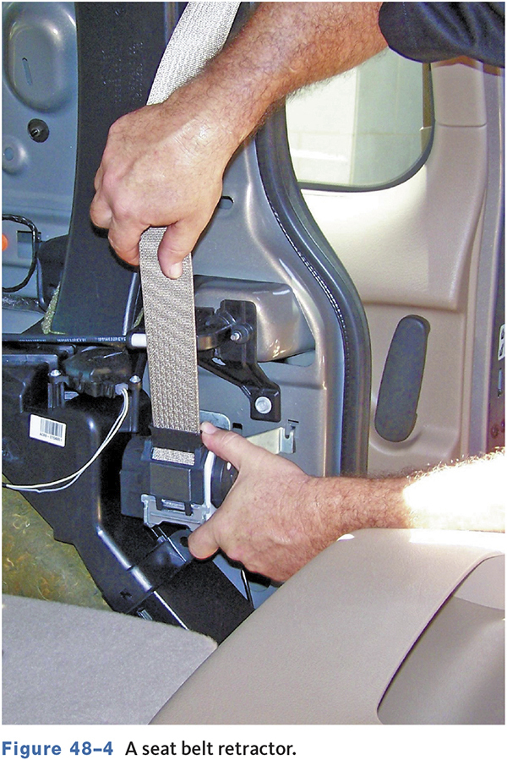
Seat Belt Retractors (1 of 2)
May operate as pretensioners to take up slack during an accident.
Inertia lock retractors prevent movement when there is a sudden pull.

Slide 7
Seat Belt Retractors (2 of 2)
Some vehicles use electric or pyrotechnic pretensioners.
These are used to pull the seat belt in during a collision.
This keeps the passenger tight against the seat.

Slide 8
Warning Lights
All modern vehicles use a reminder light or chime.
Once a seat belt is fastened, a signal is sent to the indicator module.
If a seat belt remains unfastened, an alert will sound.
A sensor in the seat detects occupant.

Slide 9
Seat Belt Service
48.02 Know how to service and repair passive belt systems.
Pay special attention to where the webbing contacts maximum stress points.
If webbing is stuck in the retractor, check for dirt or foreign material on webbing.
Never bleach or dye the belt webbing.

Slide 10
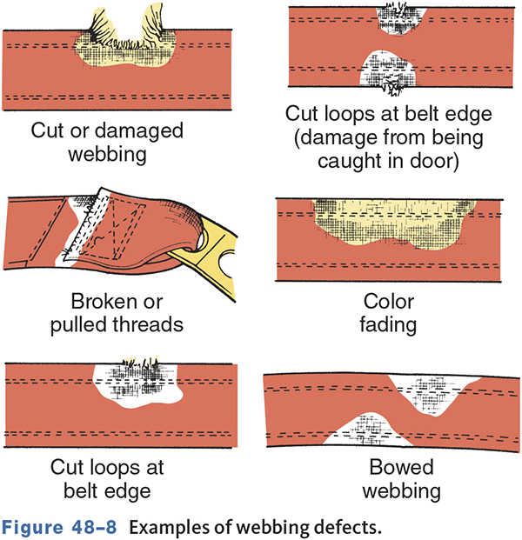
Belt Webbing Defects

Slide 11
Buckle Inspection
Insert seat belt until a click is heard.
Quickly pull on the webbing to ensure it is properly latched.
Replace the assembly if it fails to latch.
Press the seat belt release
  Should release with about two pounds of pressure.

Slide 12
Retractor Inspection
Lap belt retractors should lock once the belt is fully out.
Vehicle-sensitive retractors tested by a braking test
  Drive vehicle at 5–8 mph and stop quickly.
Most retractors are not interchangeable.

Slide 13
Anchor Inspection
Inspect anchor areas and attaching bolts.
Clean the inside of the loops.
Replace loose bolts.
Inspect the metal in the anchor mounting area.
Inspect and test rear seat restraints in the same way as front restraints.

Slide 14
Warning Light and Sound System
Warning light should come on with key in on or run position.
Should also be a warning chime.
Check for blown fuse if light and/or chime is inoperative.

Slide 15
Servicing Seat Belts
Replace the seat belt with a new assembly if there is any abnormality.
Never disassemble any part of the seat belt system.
Never attempt repairs on lap or shoulder belt retractors or retractor covers. Replace them if necessary.
Tighten all anchor bolts to specifications.

Slide 16
Knowledge Check (1 of 3)
Technician A says a faulty seat belt retractor should be disassembled, inspected, and repaired. Technician B says a faulty retractor should be replaced.
Who is correct?

Slide 17
Knowledge Check Answer (1 of 3)
Technician A says a faulty seat belt retractor should be disassembled, inspected, and repaired. Technician B says a faulty retractor should be replaced.
Who is correct?
Answer: Technician B Only

Slide 18
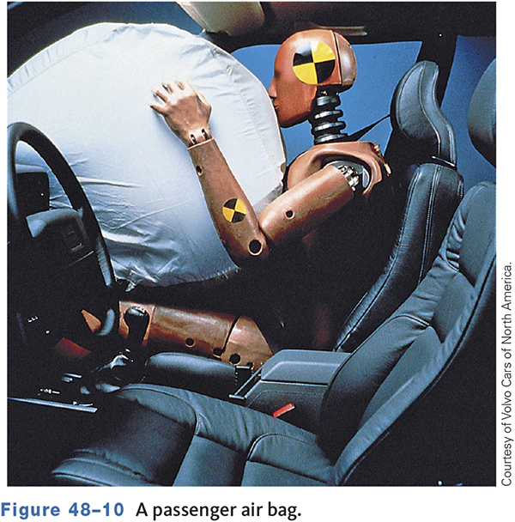
Air Bags
48.03 Describe the function and operation of air bags.
Designed to be used with seat belts.
Sensors and components vary with vehicle manufacturer and year of vehicle.
May include driver, passenger, side, curtain, and knee air bags.

Slide 19
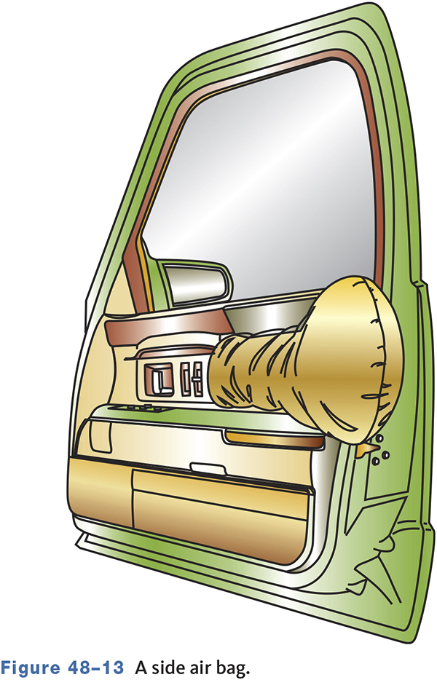
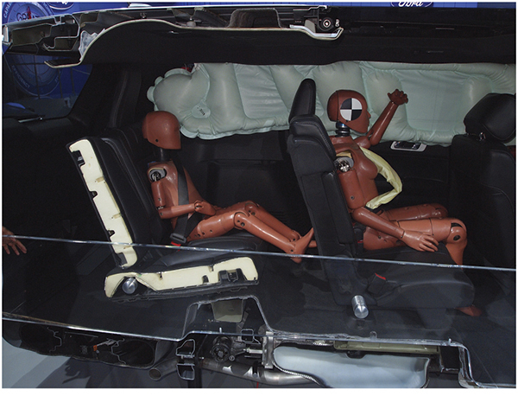
Side Air Bags

Slide 20
Typical Air Bag Deployment Sequence (1 of 2)
When a crash occurs, the arming sensor will close first, and then one of the crash sensors will close.
Within 40 milliseconds, the igniter module burns the propellant and inflates the bag.

Slide 21
Typical Air Bag Deployment Sequence (2 of 2)
Within 100 milliseconds, the air bag starts to deflate.
Within 2 seconds, the air bag is completely deflated.

Slide 22
Second-Generation Air Bags
Inflate with less force.
Designed to reduce the number of injuries caused by air bags.
Second generation bags deploy with about 20 to 35 percent less energy.

Slide 23
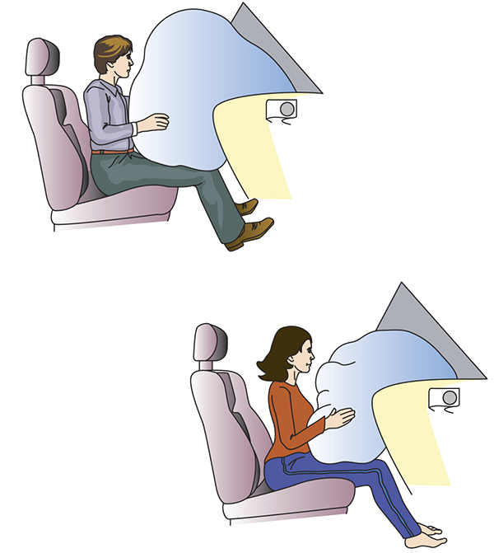
Smart (adaptive) Air Bags

Slide 24
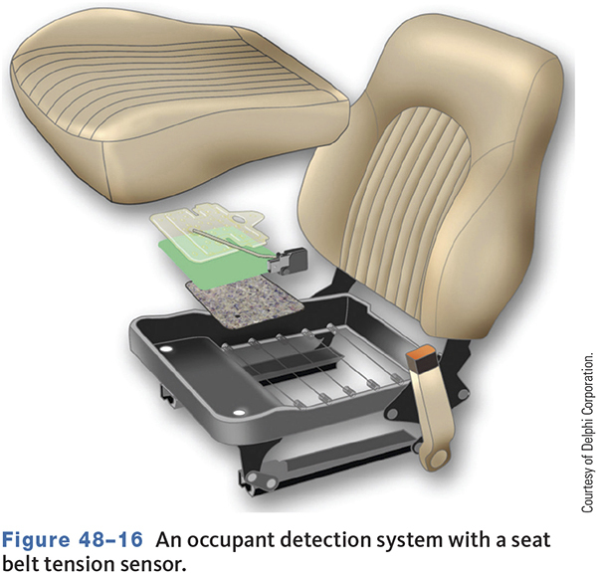
Adaptive SRS Systems
All 2006 and newer vehicles must allow for air bag suppression when infants, children, or small adults are in front passenger seat.
Uses a load sensor in seat.
Seat belt tension sensor.

Slide 25
Electrical System Components
Impact sensors.
Electronic control module(s).
Sensors send a signal to the module, which sends current to the inflator.
Most systems require at least two sensor switches to close before an air bag is deployed.

Slide 26
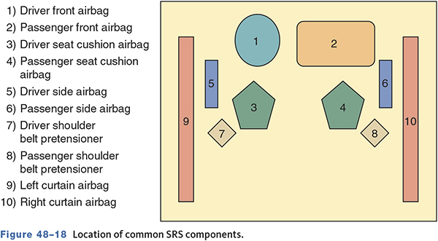
Common Air Bag Components
48.04 Identify the major parts of a typical air bag system.

Slide 27
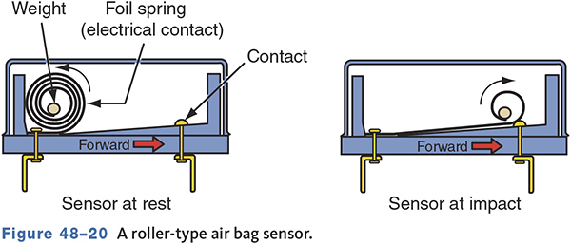
Impact—Safing Sensors
Roller-Type
  During impact, the roller moves and completes the circuit.

Slide 28
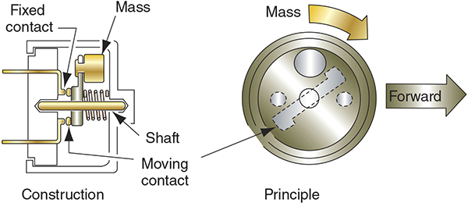
Impact—Safing Sensors (1 of 2)
Mass-Type
  Sensing mass breaks loose with sufficient force.

Slide 29
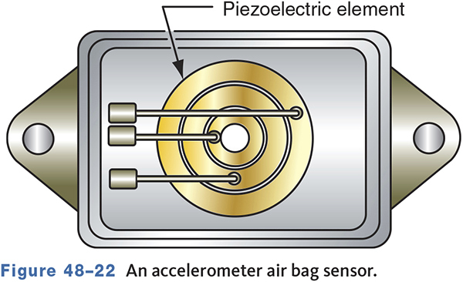
Impact—Safing Sensors (2 of 2)
Accelerometer
  Uses a piezoelectric sensing element.

Slide 30
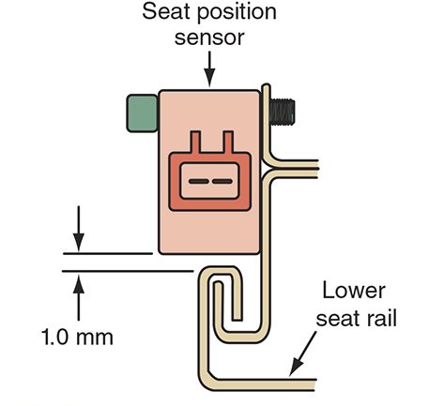
Seat Position Sensor
Mounted on seat rail.
Usually a magnet and Hall-effect switch.
Detects when seat is in a forward position.
When the seat is forward, the air bag deploys with decreased force.

Slide 31
Seat Belt Buckle Switch
Detects whether the seat belt is fastened.
Also uses a magnet and Hall-effect switch.
The magnetic field changes as the seat belt is fastened and unfastened.
Air bag deployment force is adjusted according to switch input.

Slide 32
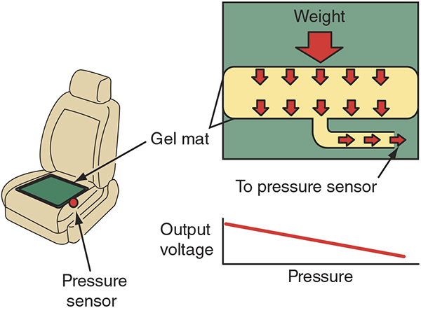
Occupant Classification Sensor
Occupant weight is measured to determine front air bag deployment force.
If no occupant is detected, the air bag will not deploy.
Most use a silicone-filled mat with a pressure sensor.

Slide 33
Wiring Harness
For identification and safety purposes, SRS components usually have yellow connectors.
All SRS connectors have gold-plated terminals.
Connectors also use a shorting bar to prevent accidental deployment.

Slide 34
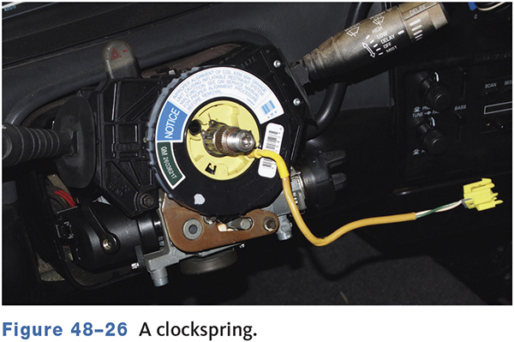
Clockspring
Maintains the electrical connection to the air bag regardless of steering wheel position.
Contains a long conductive ribbon.

Slide 35
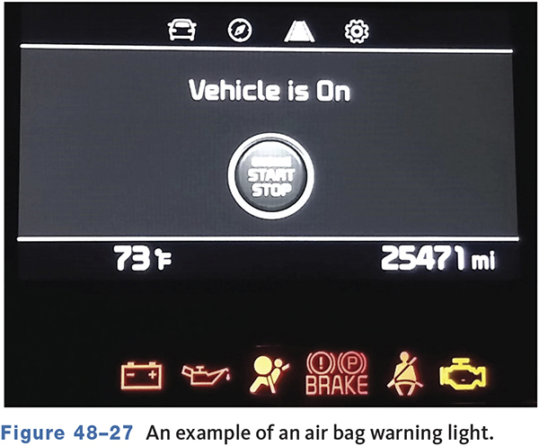
SRS or Air Bag Readiness Light
Operated by the diagnostic module.
Turns on briefly when ignition turned on.
A malfunction causes the light to stay on or flash.

Slide 36
Air Bag Module
Contains the air bag and inflator.
Inflation is usually accomplished by an explosive release of nitrogen gas.
Voltage is applied to the squib, igniting the gas canister.
Some air bags use compressed argon gas.

Slide 37
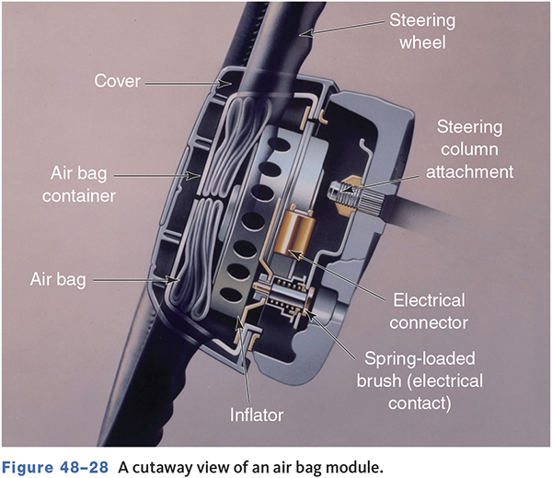
A Cutaway View of an Air Bag Module

Slide 38
Knowledge Check (2 of 3)
What type of air bag system uses two inflators?

Slide 39
Knowledge Check Answer (2 of 3)
What type of air bag system uses two inflators?
Answer: Smart or adaptive air bags

Slide 40
Air Bag Diagnosis (1 of 2)
48.05 Diagnose faults with restraint systems.
Always perform a system check first.
Check the warning lamp for proper operation.
Use the recommended procedure to retrieve fault codes if available.
Follow the manufacturer’s procedures to repair the fault.
Clear trouble codes when system is repaired.

Slide 41
Air Bag Diagnosis (2 of 2)
Testing individual components must be done with care to prevent accidental deployment.
Air bag simulators are installed in place of the air bag.
Provides normal electrical load to alloy accurate testing of air bag circuits.

Slide 42
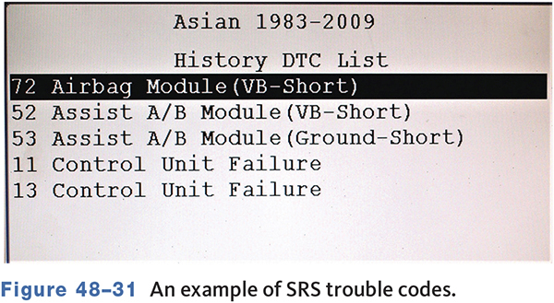
Retrieving Diagnostic Trouble Codes

Slide 43
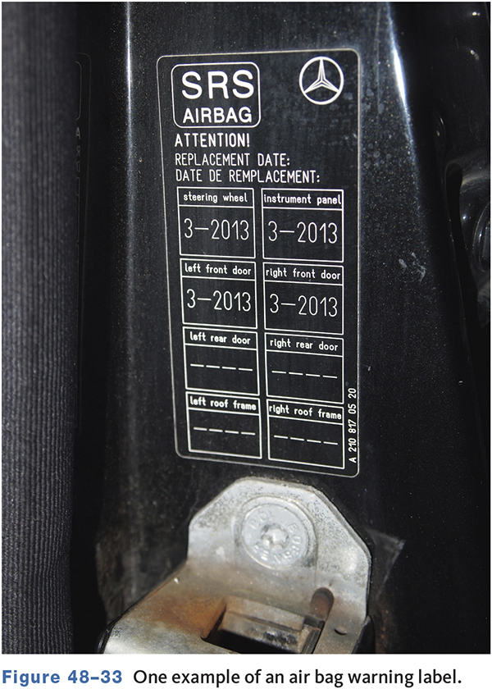
SRS Safety Warning

Slide 44
Servicing the Air Bag System( 1 of 5)
48.06 Know how to diagnose and service an air bag system.
When working inside of the vehicle, be aware of locations of all air bags.
Always wear safety glasses.
Wait at least 5 minutes after disconnecting the battery before performing any service.

Slide 45
Servicing the Air Bag System (2 of 5)
Follow service procedures exactly.
Never disassemble or attempt to repair any parts.

Slide 46
Servicing the Air Bag System (3 of 5)
Handle sensors with care.
When carrying a live air bag module, face the trim and bag away from your body.
Do not carry the module by its wires or connector.

Slide 47
Servicing the Air Bag System (4 of 5)
When placing a live module on a bench, face the trim and air bag up.
Wear safety glasses and gloves when handling deployed air bags and wash your hands immediately after handling the bag.

Slide 48
Servicing the Air Bag System (5 of 5)
A live air bag module must be deployed before disposal.
Use only test equipment specified in the service manual.
Do not use a battery- or AC-powered voltmeter, ohmmeter, or any other type of test equipment not specified in the service information to test the air bag module.
After work on the SRS is completed, perform the SRS warning light check.

Slide 49
Service Guidelines
48.07 Safely disable and inspect an air bag assembly.
An air bag module is serviced as a complete assembly.
A damaged crash sensor must be replaced.
Typically, when an air bag or bags have deployed, the control module and sensors must be replaced in addition to the air bags.
The new control module will likely need to be programmed with a scan tool once installed.

Slide 50
Knowledge Check (3 of 3)
Technician A says the air bag module must be replaced after an air bag has deployed. Technician B says the new control module will likely need to be programmed with a scan tool once installed.
Who is correct?

Slide 51
Knowledge Check Answer (3 of 3)
Technician A says the air bag module must be replaced after an air bag has deployed. Technician B says the new control module will likely need to be programmed with a scan tool once installed.
Who is correct?
Answer: Both Technicians A and B

Slide 52
Other Protection Systems (1 of 2)
48.08 Identify other components of occupant protection systems.
Headrests
  Are designed to prevent whiplash.
  Should be positioned to top of ears and less than four inches from back of head.
Event Data Recorder (EDR)
  Records air bag diagnostic and deployment data.
  Also records engine speed, throttle and brake pedal data.

Slide 53
Other Protection Systems (2 of 2)
Pre-Collision System
  Predicts possible collisions using radar.
  Retracts seat belts and alerts occupants.
Rollover Protection
  Some vehicles are equipped with automatic roll bar.
  During rollover, the air bags stay inflated longer.

Slide 54
Chapter Reflection
Describe a concept from this chapter that challenged you the most.
Describe what made the concept difficult for you and the steps you took to improve your understanding.
How could you help another student who was struggling with the same concept.
Use 100– 150 words in your answer.

